Slide 1

Flash Lidar Object Detection and Tracking
Deep Samal
Evan T Gebhardt
Prof. Marilyn Wolf
ECE, Georgia Institute of Technology

Slide 2
What is Flash Lidar?
Sensors arranged in 2D arrangement. Each sensor corresponds to one pixel in a 2D image.
When triggered, entire scene, within the camera's FoV, is illuminated with multiple laser flash pulses.
Each pixel records the time it took for a pulse to travel from being emitted by laser source and being received at the sensor, after reflection from an object's surface. This is also called 'time of flight' data.
Output of each frame is a 2D image with 2 channels- depth and intensity.

Slide 3
How is Flash Lidar different from other Lidars?
Feature | Scanning Lidar | Flash Lidar
Principle of operation | 1D Scanning sensor arrays | 2D image sensor
Field of View | 360 x 28 degrees (Velodyne) | 30 x 7.5 degrees
Horizontal Angular Resolution | 0.08 degrees | 0.234 degrees
Number of data points per frame | 120,000 | 4,096
Moving Parts | Yes (Velodyne) | No
Frame Rate | ~10 fps | 25 fps
Operating wavelength | ~900 nm | 1570 nm
S/N Ratio

Slide 4
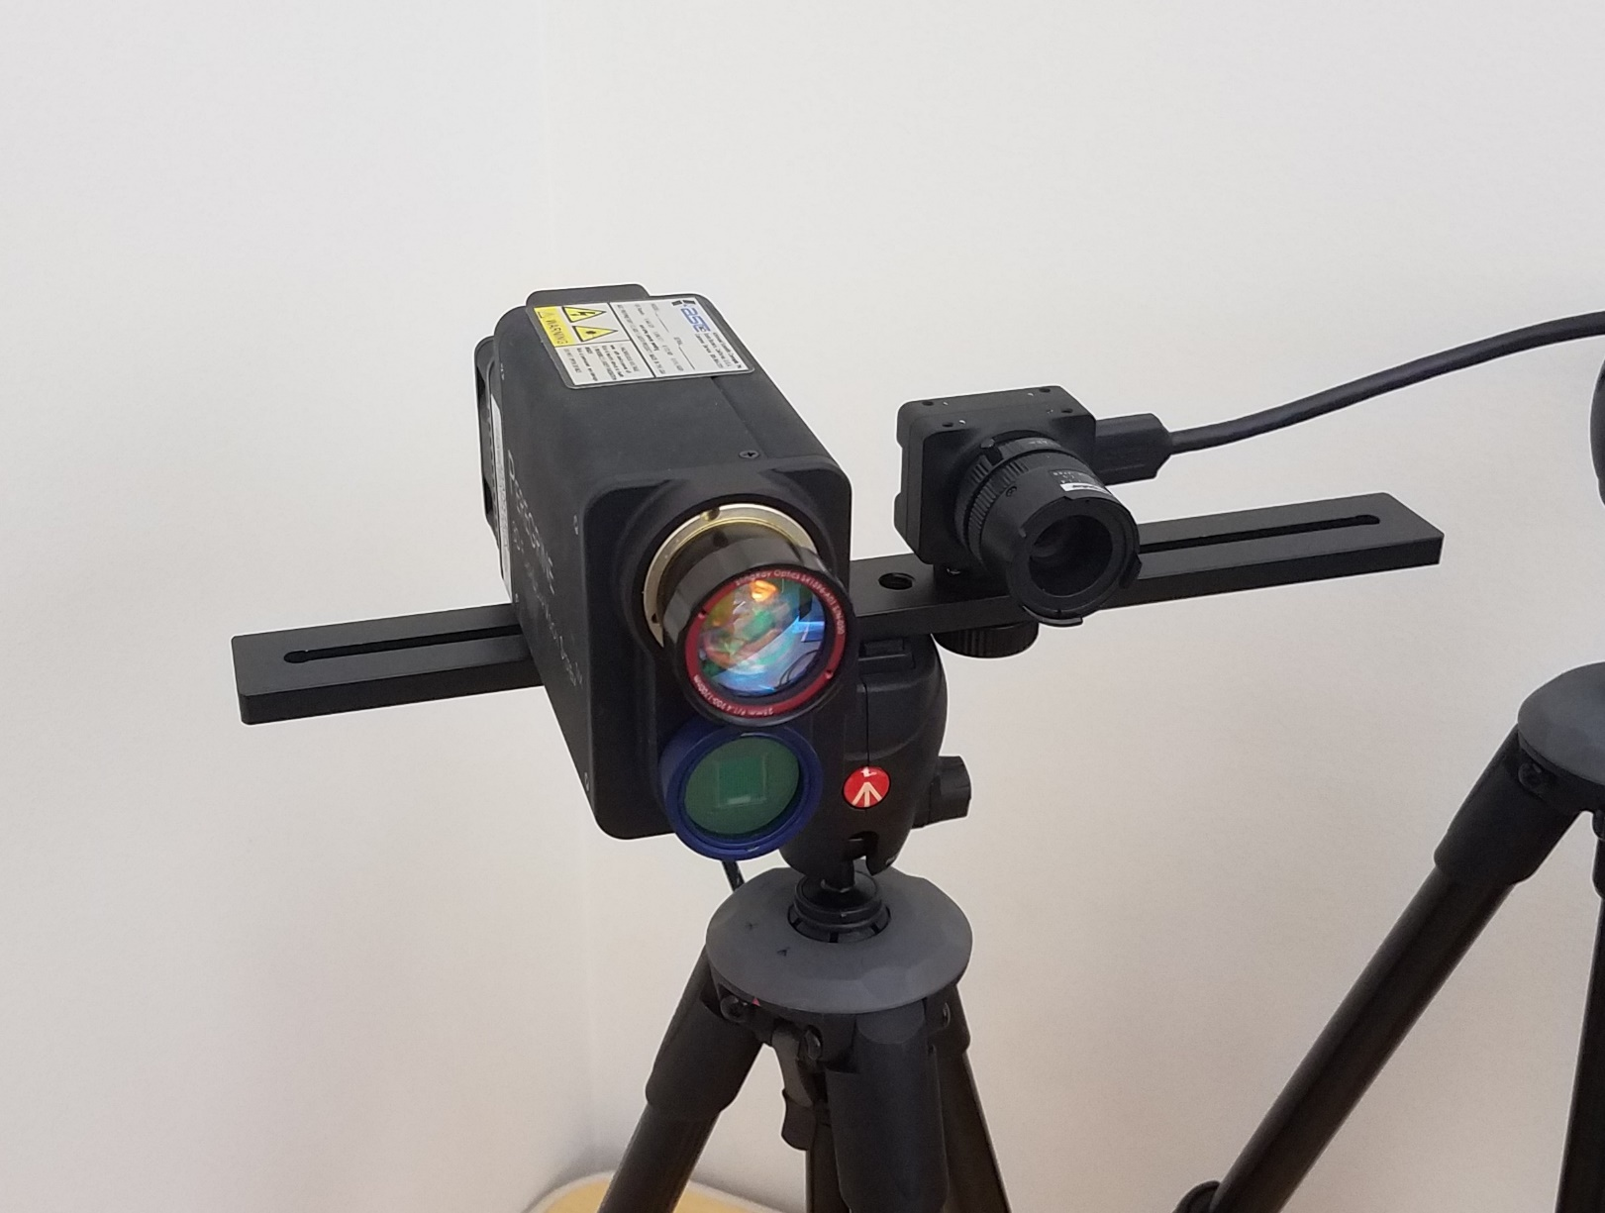
Our Hardware set-up
RGB Camera: Chameleon3
Lidar: ASC Peregrine Flash Lidar
Trigger and Sync:
Trigger on demand. Software sync.
Operating frequency at ~10 fps.
Uncalibrated RGB and Lidar.
RGB Slave
Master Program
Lidar Slave

Slide 5
Existing Lidar Object Detection Techniques
RGB + Lidar:
Requires calibrated Lidar + RGB set-up.
Cascaded logic- first detect object in RGB then crop out 3D points corresponding to the 2D 'area of interest'. These subset of points are processed using pointnet to localize 3D bounding box for the object.
Lidar only:
Process 3D points directly.
Voxelnet: sparse convolutions
3D FCN: requires volumetric convolutions
PointPillars
Point cloud clustering + template matching:
Limited application due to hardcoded features.

Slide 6
CAMEL Dataset
Purpose: provide a benchmark for visual-infrared and flash lidar object detection and tracking.
Application:
Surveillance scenario
Autonomous Driving
Recording Statistics:13 sequences with 374 unique tracks from cluttered urban scenarios. (See tables)
Location: Data was collected from places around Georgia Tech campus in Atlanta.
Annotation tool: CVAT
Split | Number of Annotated Frames
Train | 6876
Test | 1406
Total | 8282
Category Name | Number of Instances
Person | 16719
Car | 1055
Bike | 223
Van | 88
Bus | 140

Slide 7
Technical approach
FCN based real-time object detection.
SORT (Simple Online Real-time Tracking) based tracking.
Features:
High frame-rate
Detection and tracking are decoupled from each other

Slide 8
Object detection
Fully Convolutional Network (FCN) + Detection Layer (Regression)
We started with YOLOv3 architecture and made modifications to its architecture and training strategy according to our data.
Changes:
Low Resolution: 32x128 vs 224x224
Depth map vs. point cloud
Decreased number of network layers from 37 to 25
Number of network parameters were decreased from 8.85 million to 102,460
Decreased number of training epochs from 250 to 50.
We do not change input image’s aspect ratio to square, rather maintain the original aspect ratio of 1:4

Slide 9
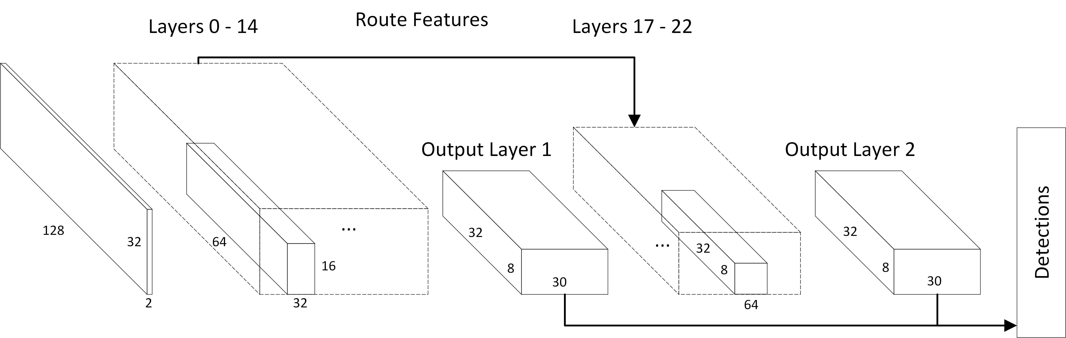
Network Architecture

Slide 10
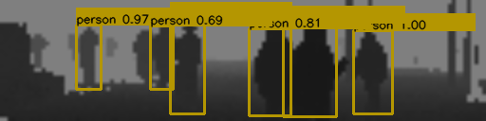
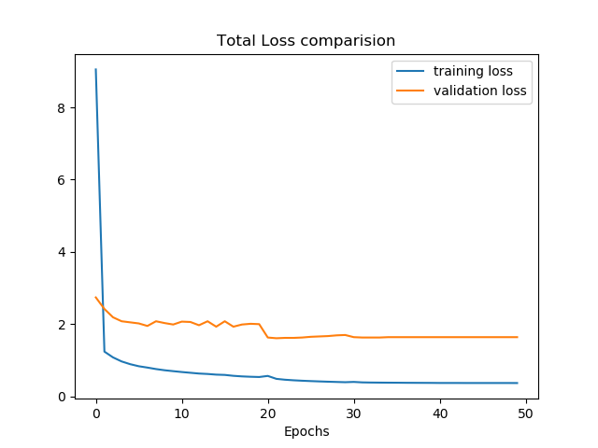
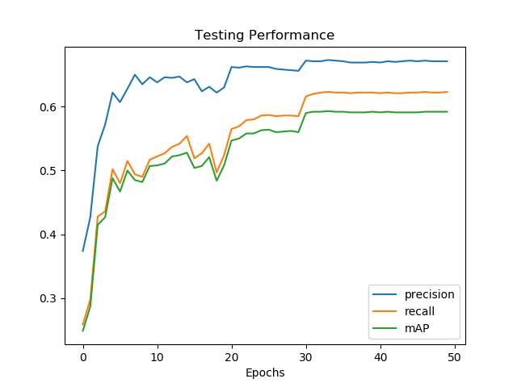
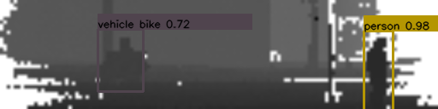

Object Detection Results
Large difference in detection performance between different categories due to class imbalance in dataset.
Loss comparison graph shows testing loss is plateauing at around epoch 20, this indicates overfitting.
Adding more data to increase generality will help as well.
Class Category | Precision | Recall | mAP
all | 0.671 | 0.622 | 0.592
person | 0.726 | 0.681 | 0.647
car | 0.439 | 0.444 | 0.439
bike | 0.160 | 0.165 | 0.160

Slide 11
Tracker
SORT based tracker adds no overhead on detection pipeline.
Performance heavily dependent on quality of detection.
It uses bounding box IoU as association metric and Kalman Filter to predict tracks.
Linear velocity filter model is used to track both center co-ordinates and scale of detected object bounding box/tracks.

Slide 12
Tracking Results
Name | IDF1↑ | IDP↑ | IDR↑ | GT | MT | PT | ML | FP↓ | FN↓ | IDs↓ | FM↓ | MOTA↑ | MOTP↓
Test 1 | 19.90% | 30.60% | 14.70% | 8 | 1 | 3 | 4 | 167 | 982 | 26 | 48 | 25.20% | 0.285
Test 2 | 47.10% | 74.80% | 34.40% | 18 | 3 | 5 | 10 | 13 | 288 | 8 | 17 | 39.30% | 0.195
Test 3 | 51.70% | 76.80% | 39.00% | 50 | 6 | 21 | 23 | 52 | 748 | 25 | 48 | 41.70% | 0.241
We follow CLEAR MOT metrics to evaluate tracking performance
We used 3 test sequences from various urban scenarios to evaluate detection and tracking performance.
MOTA and MOTP results are optimistic
IDF1, IDP and IDR metrics are poor. This indicates single tracks are being fragmented into multiple tracks. This might be a result of high false negatives from object detector.

Slide 13
Conclusion
First object detector for Flash lidar.
Small Network with ~100K parameters. Therefore faster to train and operating speed of network is ~227 fps.
We observed network overfitting even with such low number of parameters, therefore using SSD like architecture which require even more parameters is difficult.
We are currently in the process of obtaining more data, this will help with class imbalance and overfitting. Which will also help improve detection performance and hence tracking performance.

Slide 14
Thank You
Git Repository:
https://gitlab.com/deepsamal/flash-lidar-object-detection-and-tracking.git
Data Download Link:
https://www.dropbox.com/s/jsmn5v64bh7labj/data.tar.gz?dl=0
For more details contact:
Deep Samal: deep.samal@gmail.com, ksamal3@gatech.edu
Questions??

